Slide 1
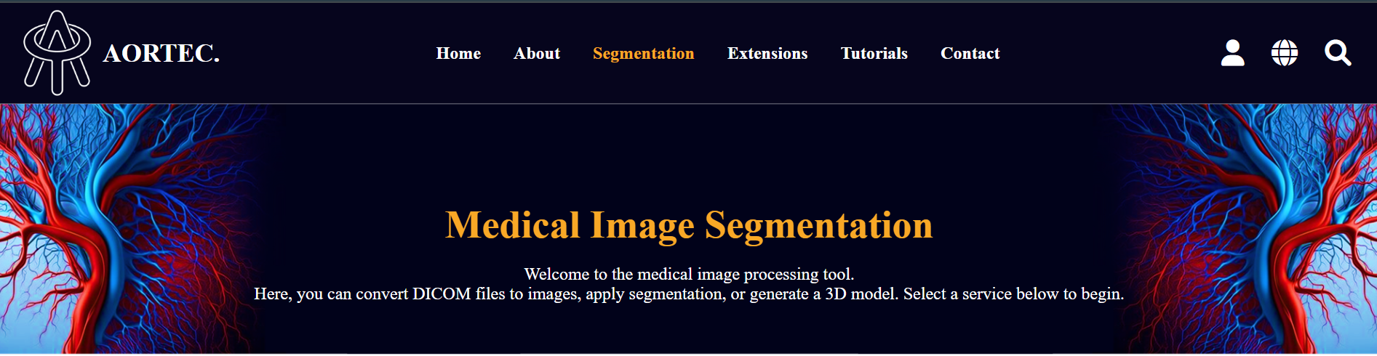
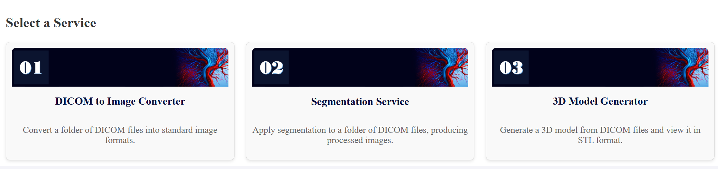
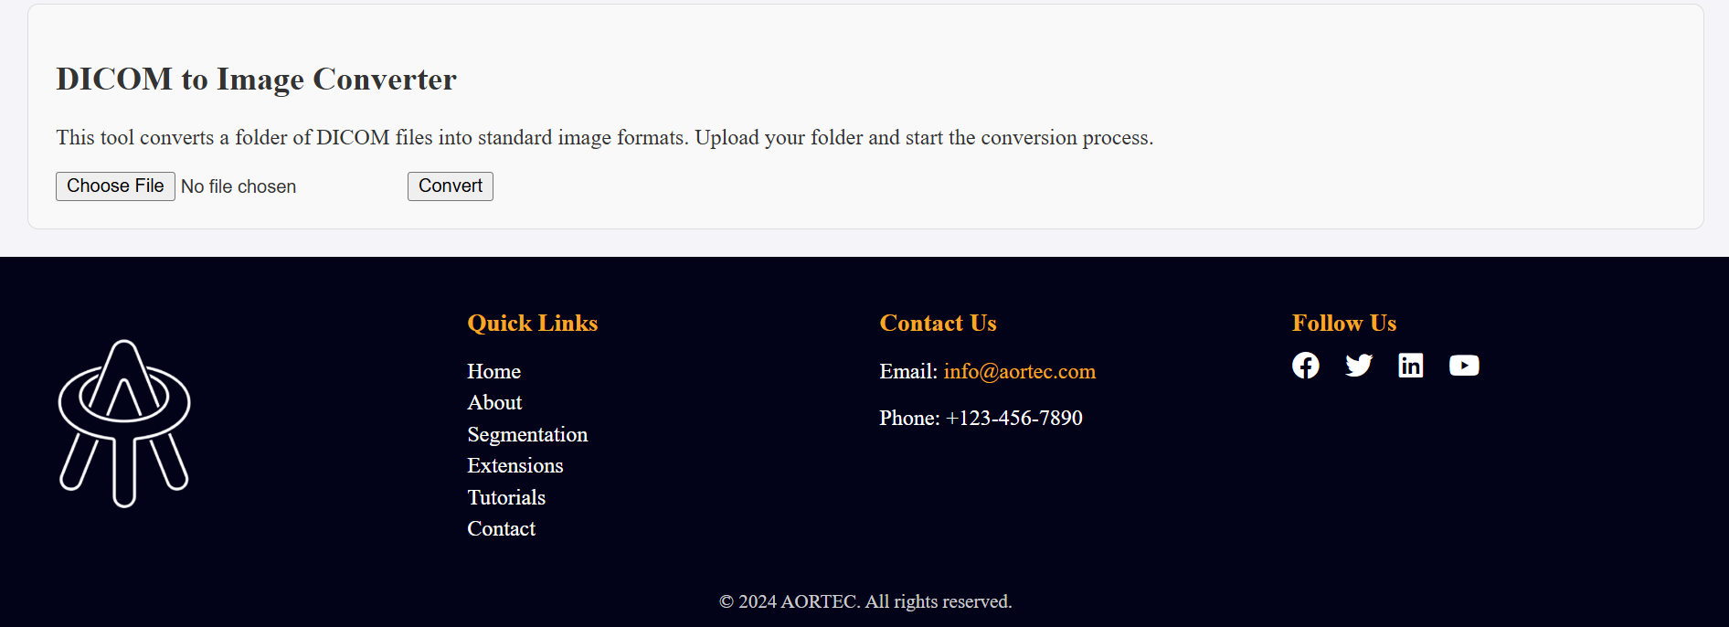

Slide 2
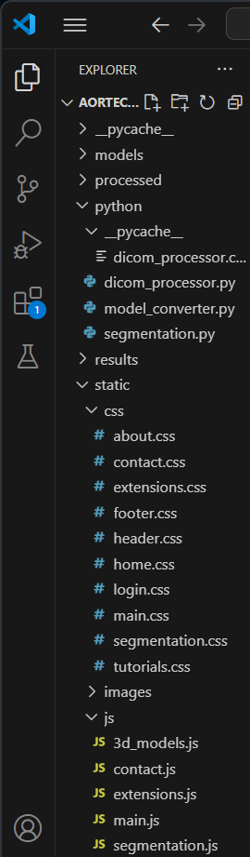
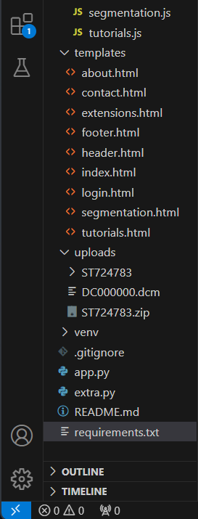
Service 3: 3D Model Conversion and VisualizationFunctionality:Convert uploaded DICOM files into segmented images and then into 3D models.Allow users to view the 3D model on the browser with options like zoom, rotation, and pan.Provide an option to download the 3D model in STL format.Implementation:Use libraries like VTK or PyVista for 3D model generation and visualization.Use JavaScript libraries like three.js for rendering the 3D model in the browser.Add a Flask route to handle the conversion and STL generation.
app.py, segmentation.html, segmentation.css, segmentation.js, dicom_processor.py, segmentation.py, model_convertor.py.
app.py: |, segmentation.html: |, segmentation.css: |, segmentation.js: |, dicom_processor.py: |, segmentation.py: |, model_convertor.py: |
Notes:
why I need styles.css file if I do not use it in my code. plus, I dont have processed location to save the converted dicom image so where the DC000000.jpg go? here what I have in my project:

Slide 3
For predicting the risk of aneurysm rupture, we can employ a data-driven approach that combines machine learning models with relevant clinical and imaging data. Here's the breakdown of the approach:
---
### **Algorithm/Idea for Predicting Risk of Rupture**
1. **Input Data**:
- **Clinical Data**: Patient age, gender, blood pressure, smoking status, family history, and other medical conditions (e.g., hypertension, diabetes).
- **Imaging Data**: Aneurysm maximum diameter, wall thickness, volume, and growth rate (from previous service).
- **Biomechanical Factors**: Wall stress, elasticity, and blood flow dynamics (if available from imaging analysis).
- **Historical Data**: Time-series growth data of the aneurysm, if applicable.
2. **Feature Engineering**:
- Extract relevant features such as:
- Aneurysm diameter-to-wall-thickness ratio.
- Aneurysm growth rate.
- Blood pressure variability over time.
- Use derived metrics like Peak Wall Stress (PWS) or Rupture Potential Index (RPI), which can be calculated using mathematical models or inferred from imaging data.
3. **Model Selection**:
- Choose a machine learning model based on the data availability and complexity:
- Logistic Regression: If the dataset is small and interpretable results are needed.
- Random Forest or Gradient Boosting (e.g., XGBoost): For moderately complex data with feature importance evaluation.
- Deep Learning (e.g., Neural Networks): For large datasets or when incorporating imaging data directly.
4. **Model Training**:
- Train the model on a labeled dataset where rupture cases (positive) and non-rupture cases (negative) are known.
- Use clinical studies or databases like UK Biobank, NIH datasets, or hospital-specific anonymized data.
5. **Validation and Testing**:
- Split data into training, validation, and testing sets.
- Use metrics like accuracy, sensitivity, specificity, and AUC (Area Under the Curve) to evaluate performance.
6. **Risk Scoring**:
- Output a risk score (e.g., 0-1 or low/medium/high risk).
- Provide threshold-based classification for rupture risk assessment.
7. **Visualization**:
- Present results with a clear risk score and feature contributions (e.g., SHAP values) for interpretability.
- Use charts or heatmaps to show the most critical factors contributing to the risk.
8. **Deployment**:
- Integrate the trained model into the system.
- Allow real-time or batch evaluation of patient data.
---
### **Discussion Points**
1. **Data Availability**:
- Do we have access to both clinical and imaging datasets?
- How can we handle missing or incomplete data?
2. **Algorithm Choice**:
- Should we start with simpler models for interpretability, or directly apply complex models for better accuracy?
3. **Validation Strategy**:
- Cross-validation, external validation datasets, or simulated datasets?
4. **Scalability**:
- Should we design this as a standalone service or integrate it seamlessly with the previous services?
---
Let me know your thoughts on this workflow. After we align on the methodology, we can begin coding!

Slide 4

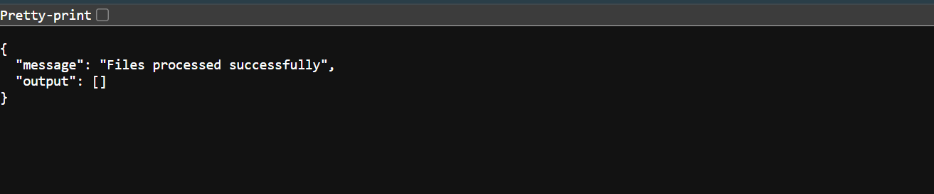
Notes:
{ "message": "Files processed successfully", "output": [] } {"message":"Files processed successfully","output":[]}

Slide 5





Slide 6


Slide 7


Slide 8


Slide 9


Slide 10


Slide 11


Slide 12


Slide 13


Slide 14
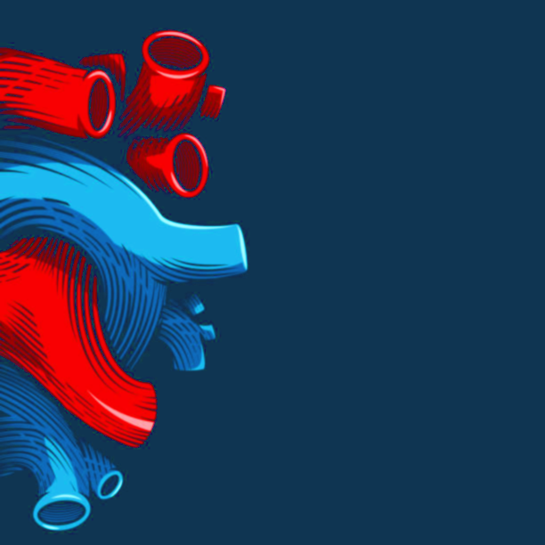

Slide 15
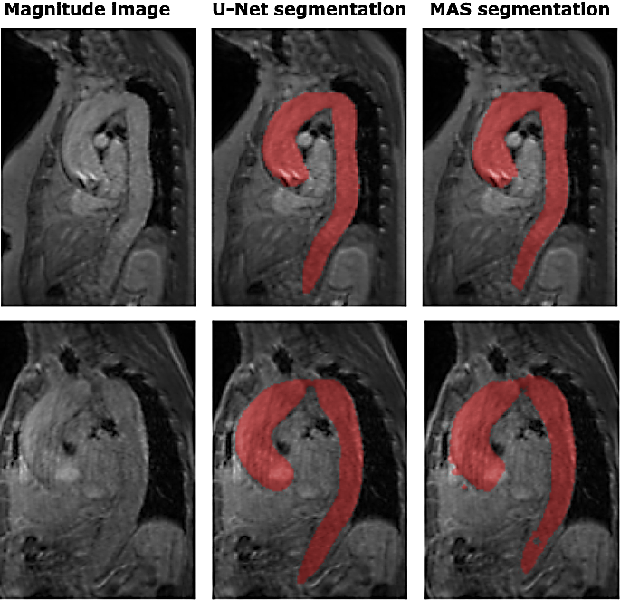

Slide 16


Slide 17
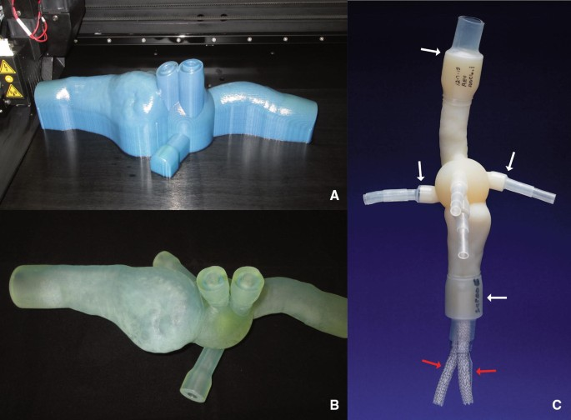

Slide 18
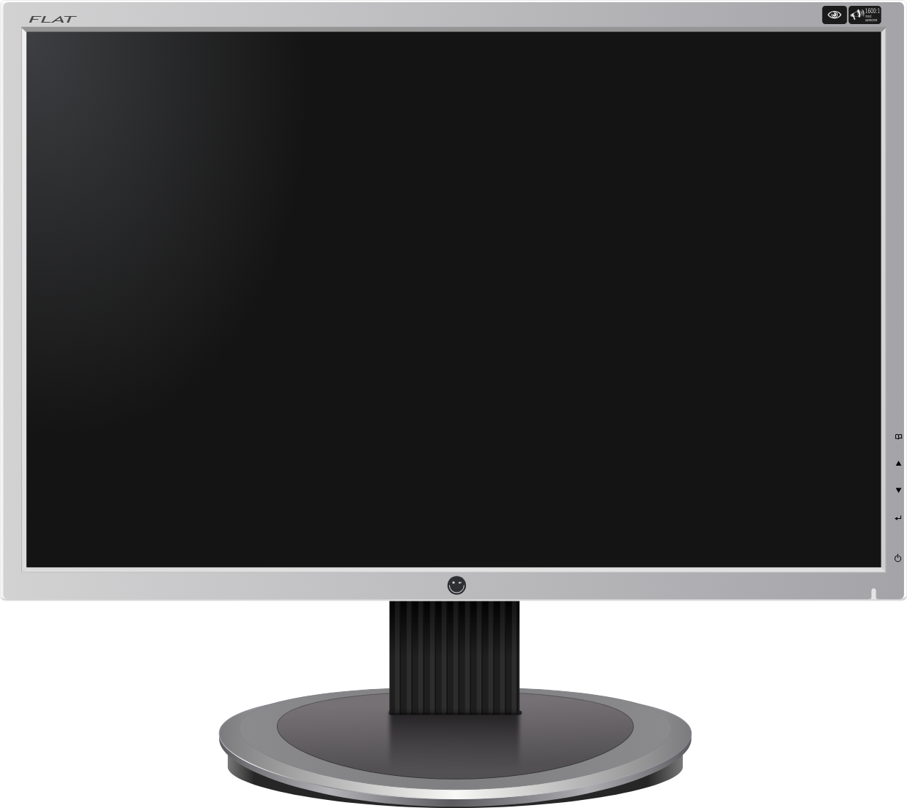
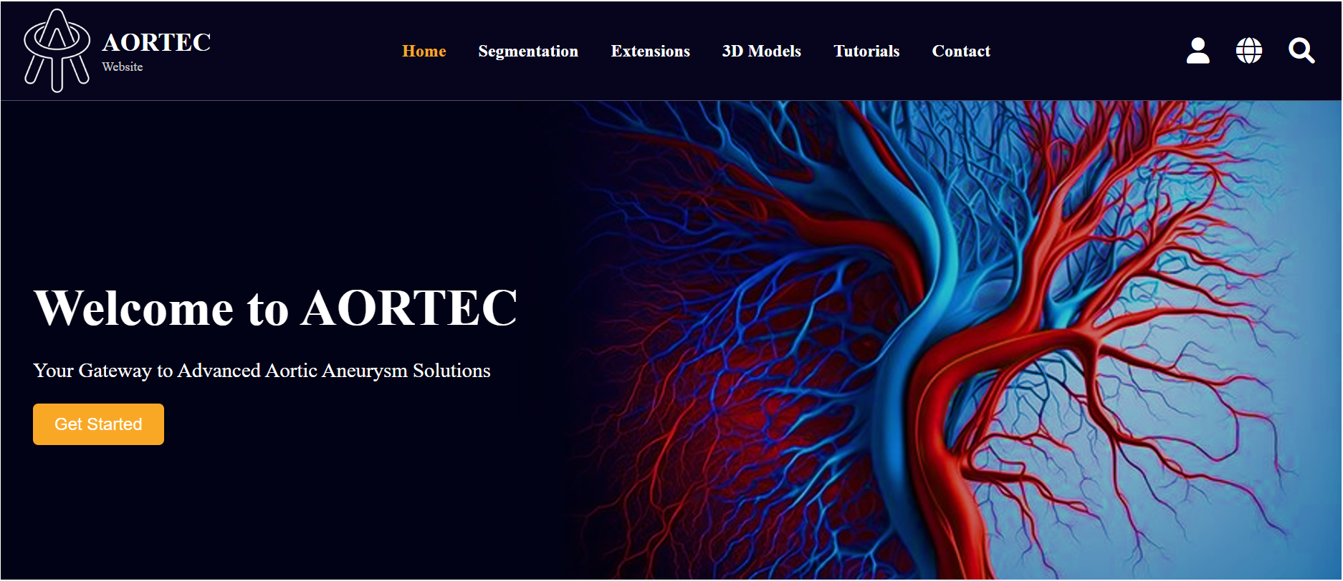
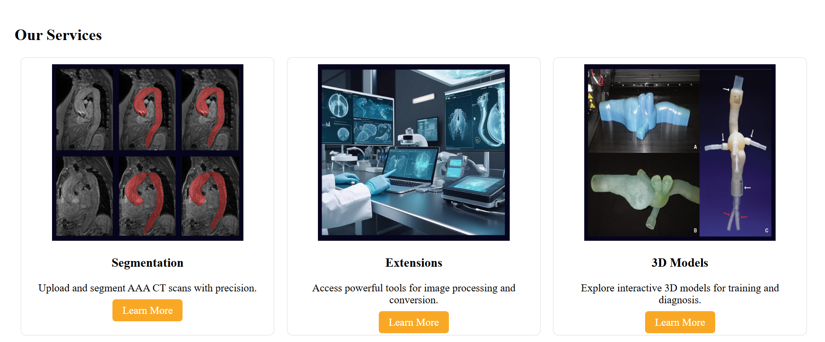
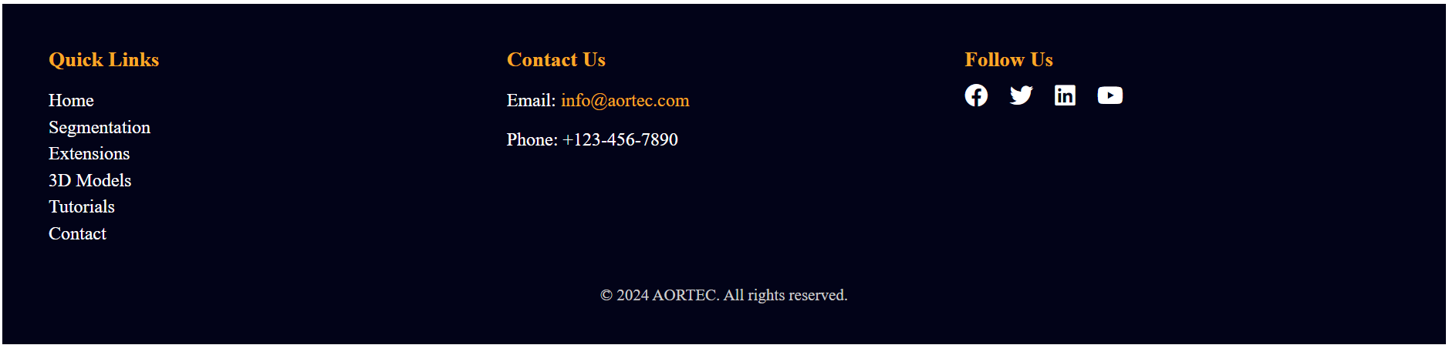

Slide 19
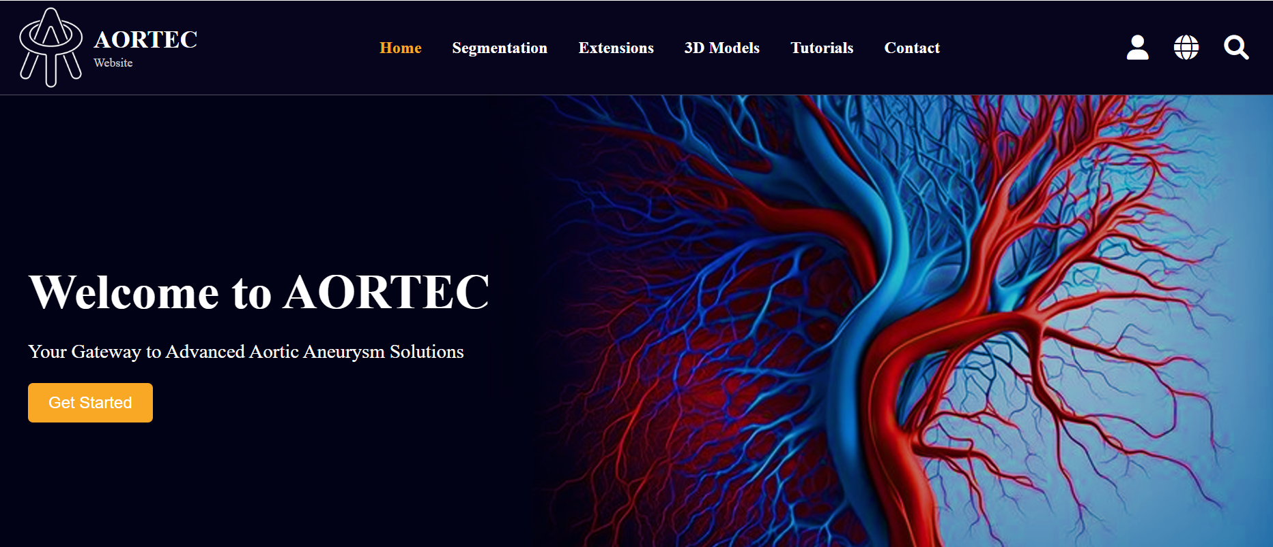
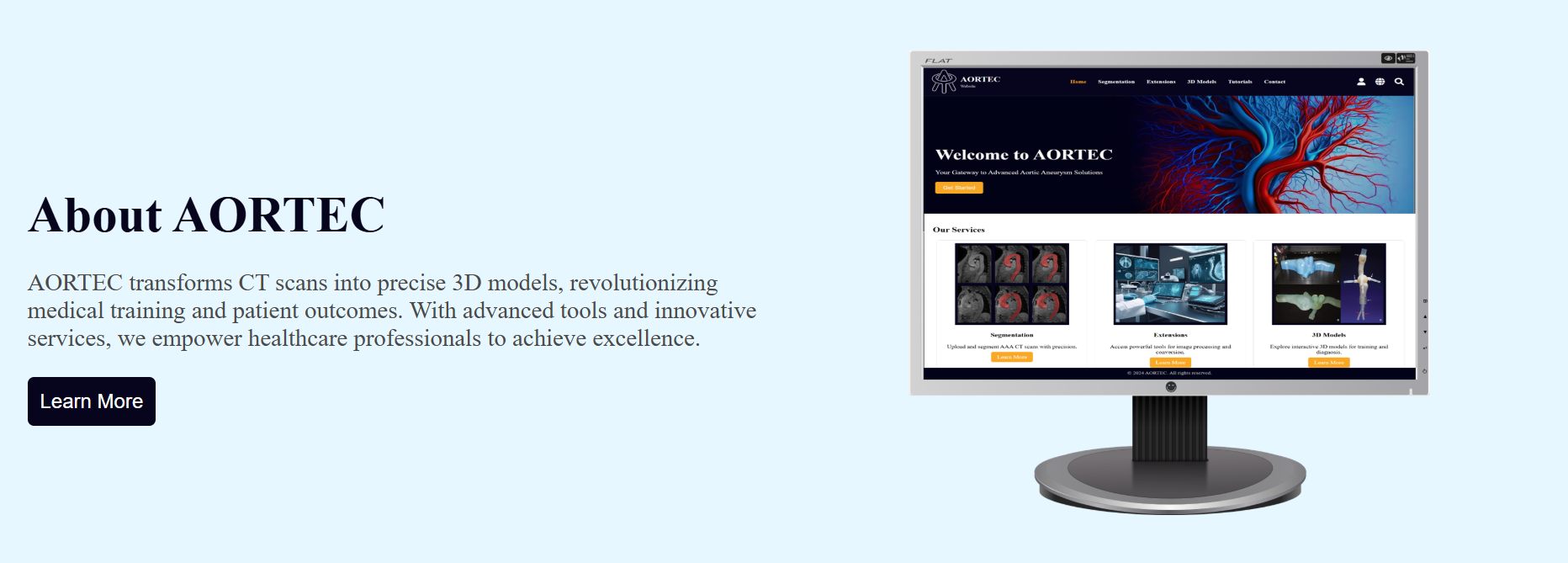
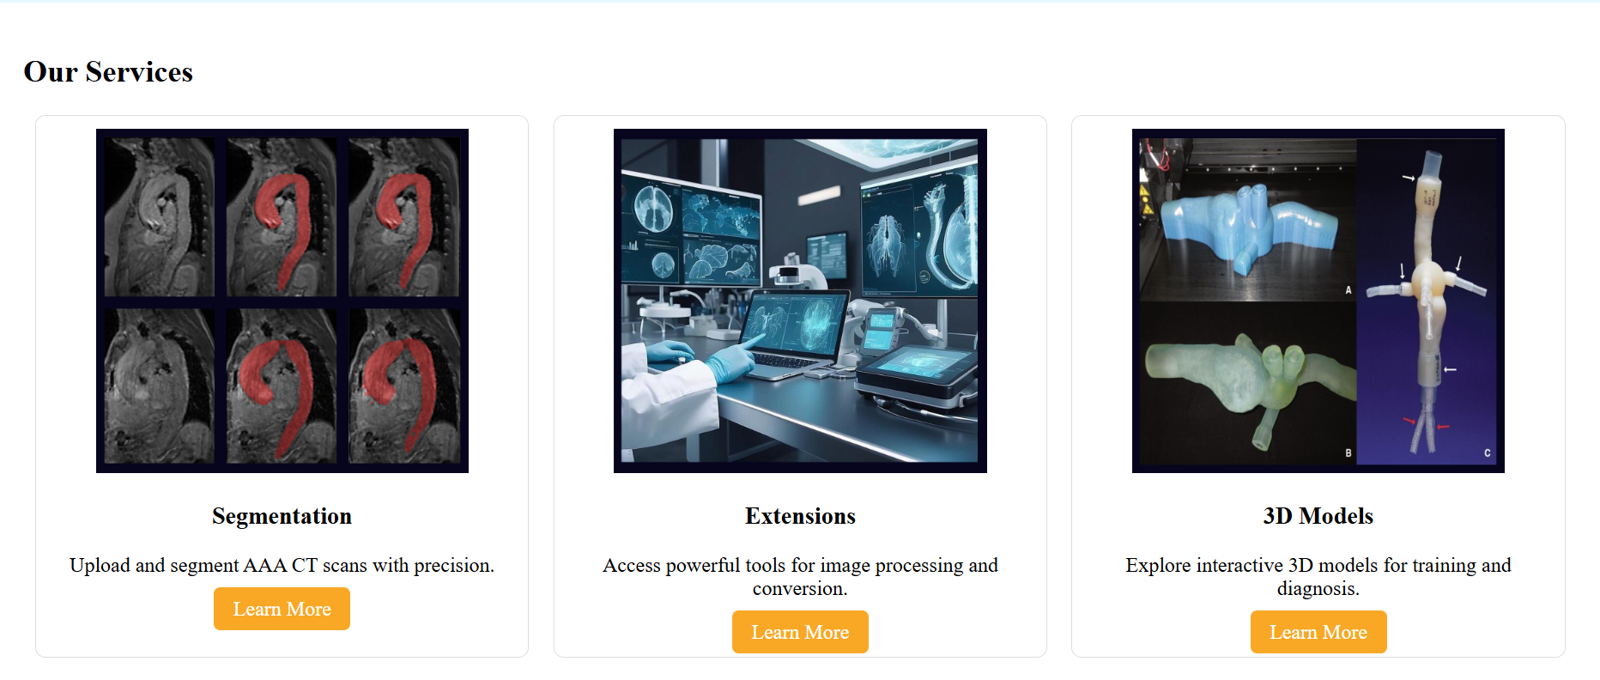
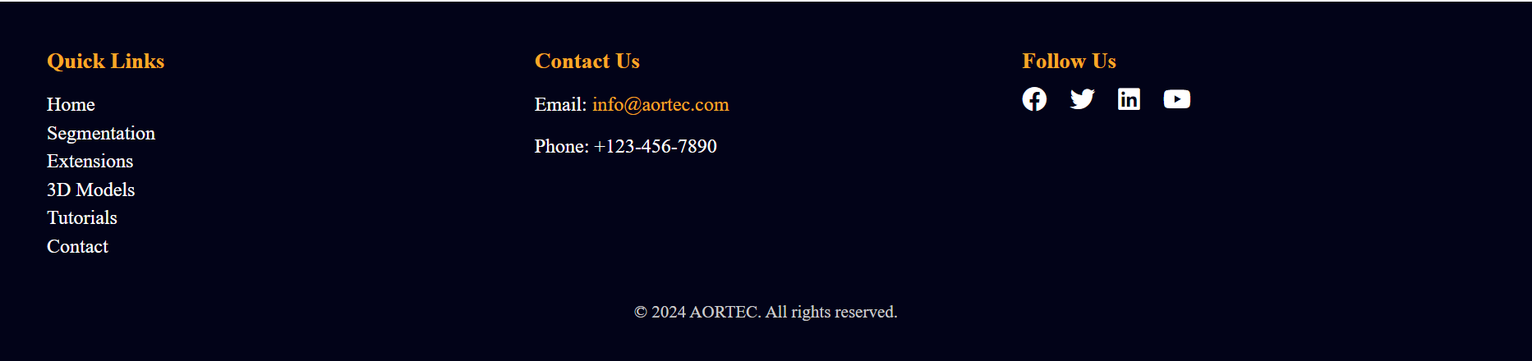

Slide 20
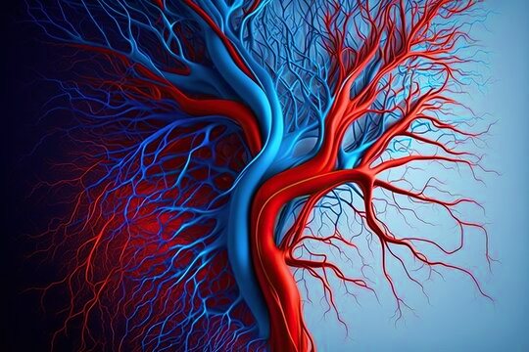

Slide 21


Slide 22
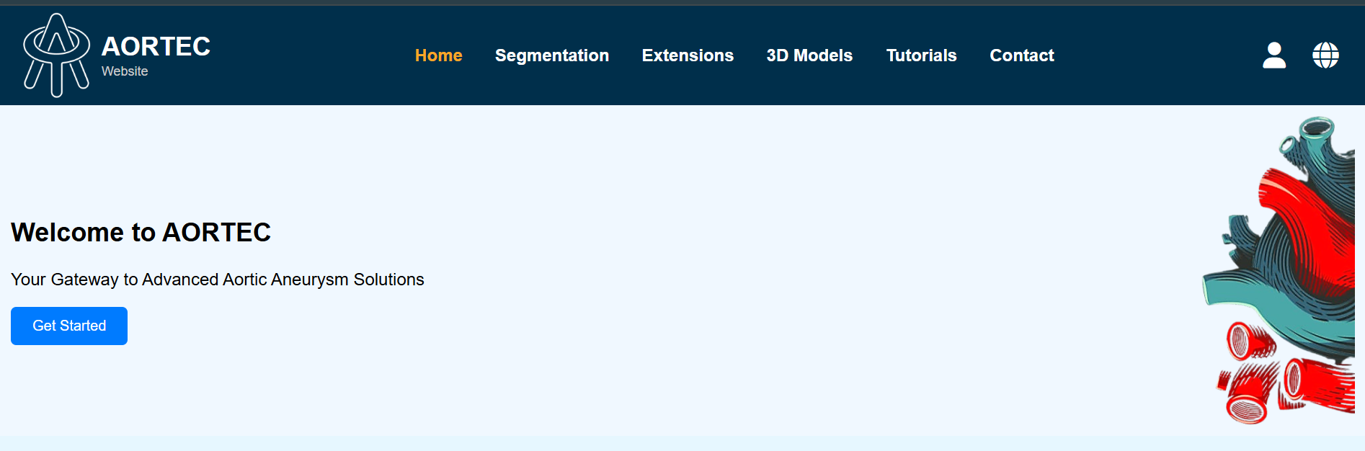

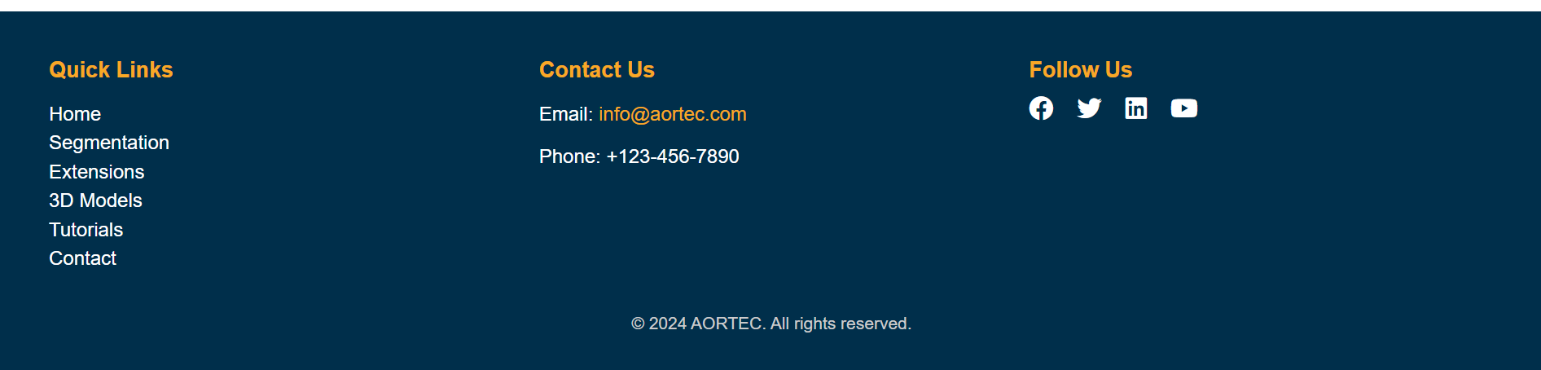
What I want the website to look like
What is the website look like now
Welcome to AORTEC
Your Gateway to Advanced Aortic Aneurysm Solutions (AAA)

Slide 24


Slide 26




Slide 27

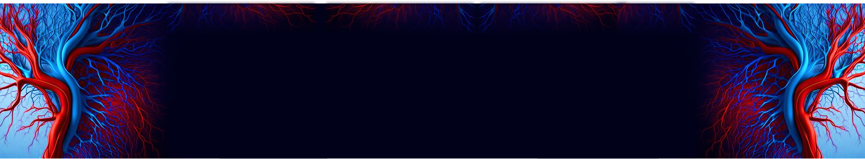

Slide 28
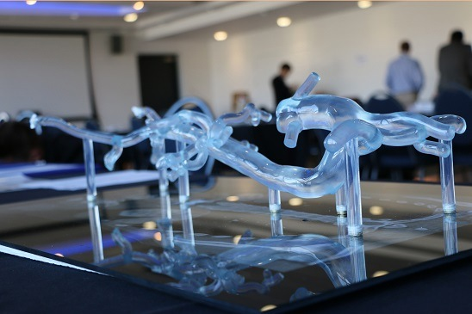

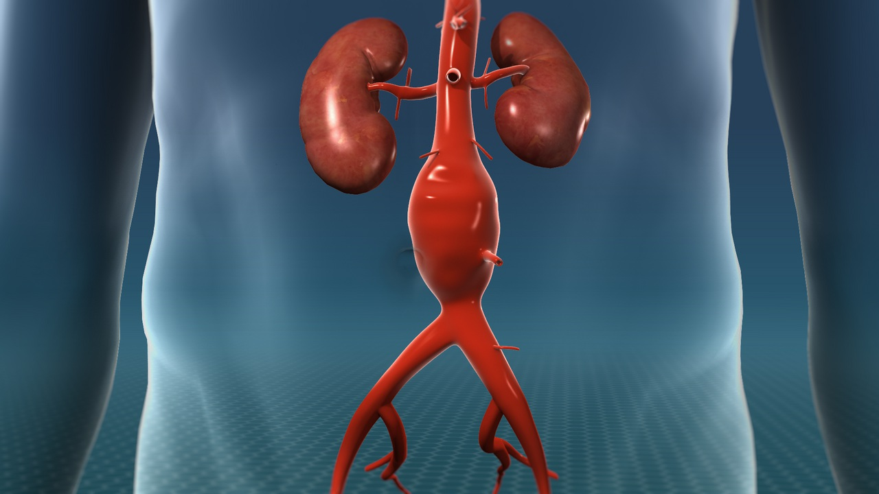
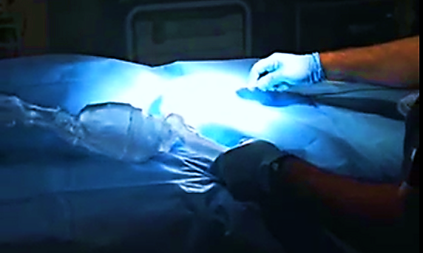

Slide 29
?
01
01
02
03
04
05

Slide 30

